Slide 1
MIS 311 PROJECT PRESENTATION
Prepared by;
Duygu Uçgun / 16030411038
Ayberk Ünveren / 17030411044
Sinan Olcaytürkan / 16030411049

Slide 2
What is the Metasploit Framework and How is it Used?
The Metasploit framework is a very powerful tool which can be used by cybercriminals as well as ethical hackers to probe systematic vulnerabilities on networks and servers. Because it’s an open-source framework, it can be easily customized and used with most operating systems.
With Metasploit, the pen testing team can use ready-made or custom code and introduce it into a network to probe for weak spots. As another flavor of threat hunting, once flaws are identified and documented, the information can be used to address systemic weaknesses and prioritize solutions.

Slide 3
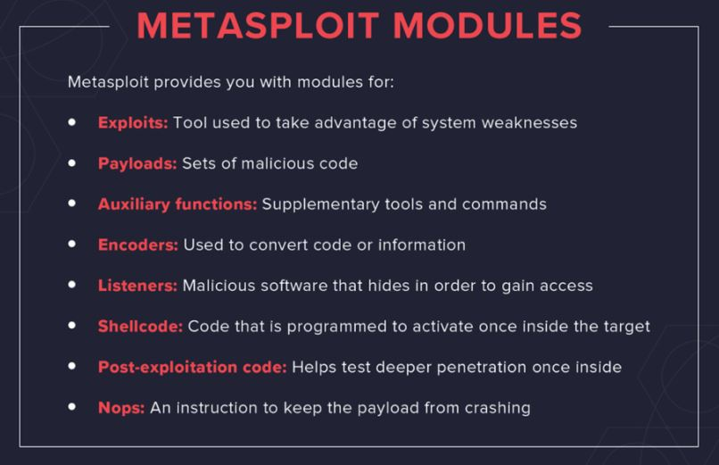
Metasploit Uses and Benefits

Slide 4
What is the EternalBlue?
EternalBlue is a Windows exploit created by the US National Security Agency (NSA) and used in the 2017 WannaCry ransomware attack.
EternalBlue exploits a vulnerability in the Microsoft implementation of the Server Message Block (SMB) Protocol. This dupes a Windows machine that has not been patched against the vulnerability into allowing illegitimate data packets into the legitimate network. These data packets can contain malware such as a trojan, ransomware or similar dangerous program.

Slide 5
What is Nmap?
Nmap is a network scanning tool that uses IP packets to identify all the devices connected to a network and to provide information on the services and operating systems they are running.
The program is most commonly used via a command-line interface (though GUI front-ends are also available) and is available for many different operating systems such as Linux, Free BSD, and Gentoo. Its popularity has also been bolstered by an active and enthusiastic user support community.
Nmap was developed for enterprise-scale networks and can scan through thousands of connected devices. However, in recent years Nmap is being increasingly used by smaller companies. The rise of the IoT, in particular, now means that the networks used by these companies have become more complex and therefore harder to secure.
This means that Nmap is now used in many website monitoring tools to audit the traffic between web servers and IoT devices. The recent emergence of IoT botnets, like Mirai, has also stimulated interest in Nmap, not least because of its ability to interrogate devices connected via the UPnP protocol and to highlight any devices that may be malicious.

Slide 6
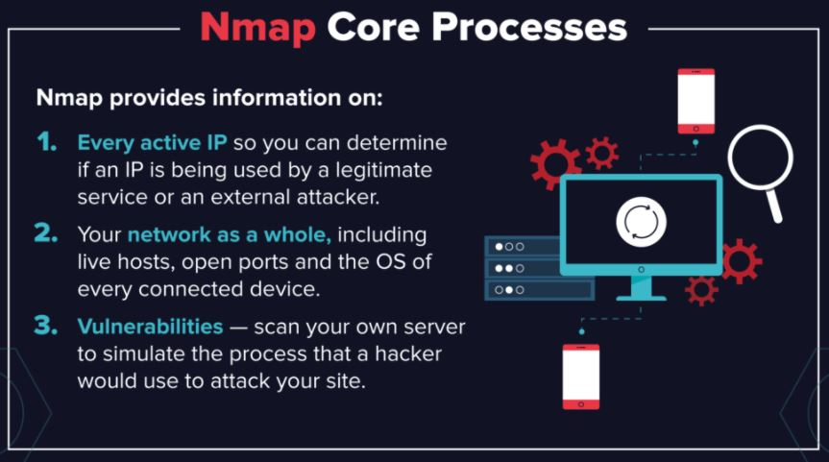
What Does Nmap Do?

Slide 7
What is Wireshark?
Wireshark is an open-source network protocol analysis software program started by Gerald Combs in 1998. A global organization of network specialists and software developers support Wireshark and continue to make updates for new network technologies and encryption methods.
Wireshark is absolutely safe to use. Government agencies, corporations, non-profits, and educational institutions use Wireshark for troubleshooting and teaching purposes. There isn’t a better way to learn networking than to look at the traffic under the Wireshark microscope.
There are questions about the legality of Wireshark since it is a powerful packet sniffer. The Light side of the Force says that you should only use Wireshark on networks where you have permission to inspect network packets. Using Wireshark to look at packets without permission is a path to the Dark Side.

Slide 8
How does Wireshark work?
Wireshark is a packet sniffer and analysis tool. It captures network traffic on the local network and stores that data for offline analysis. Wireshark captures network traffic from Ethernet, Bluetooth, Wireless (IEEE.802.11), Token Ring, Frame Relay connections, and more.
Note: A “packet” is a single message from any network protocol (i.e., TCP, DNS, etc.)
Note 2: LAN traffic is in broadcast mode, meaning a single computer with Wireshark can see traffic between two other computers. If you want to see traffic to an external site, you need to capture the packets on the local computer.
Wireshark allows you to filter the log either before the capture starts or during analysis, so you can narrow down and zero into what you are looking for in the network trace. For example, you can set a filter to see TCP traffic between two IP addresses. You can set it only to show you the packets sent from one computer. The filters in Wireshark are one of the primary reasons it became the standard tool for packet analysis.

Slide 9
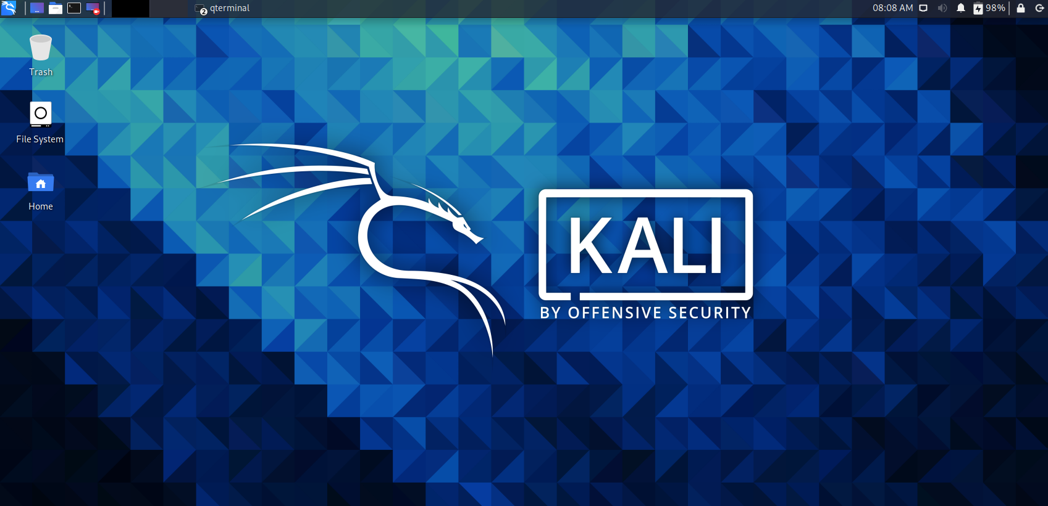
Setting up the kali linux. (https://developer.Microsoft.Com/en-us/microsoft-edge/tools/vms/)

Slide 10
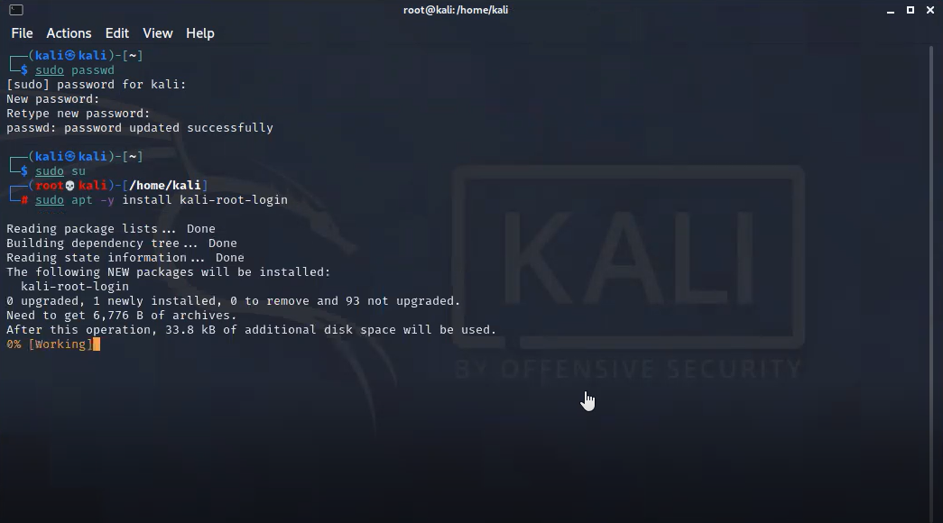
Enter the Kali as a root.

Slide 11
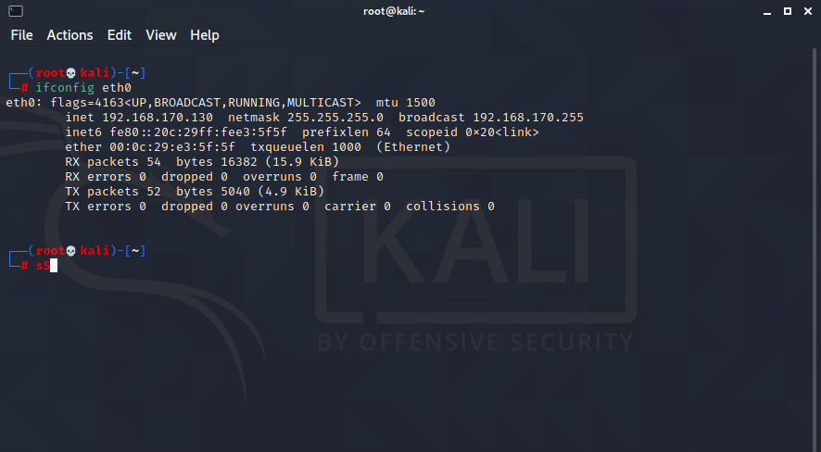
Identify the attacker’s IP with «eth0» code.

Slide 12
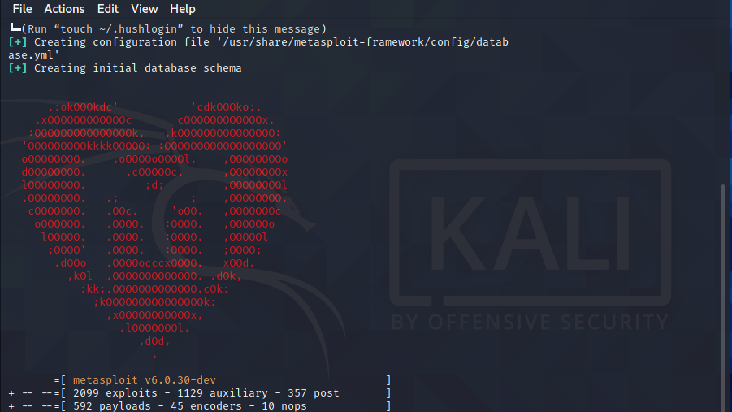
Opening the «Metasploit Framework» with «sudo msfconsole» code which is already set up on Kali Linux.

Slide 13
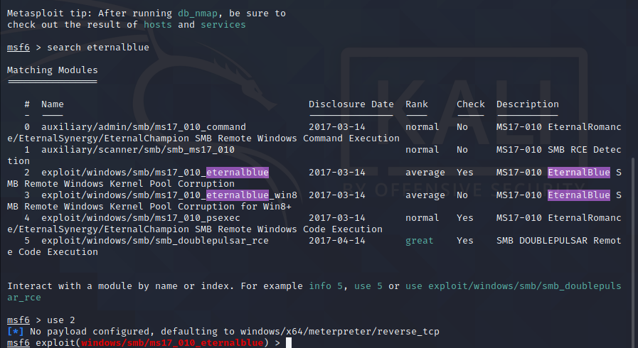
Configuring the EternalBlue with «search eternalblue» code.

Slide 14
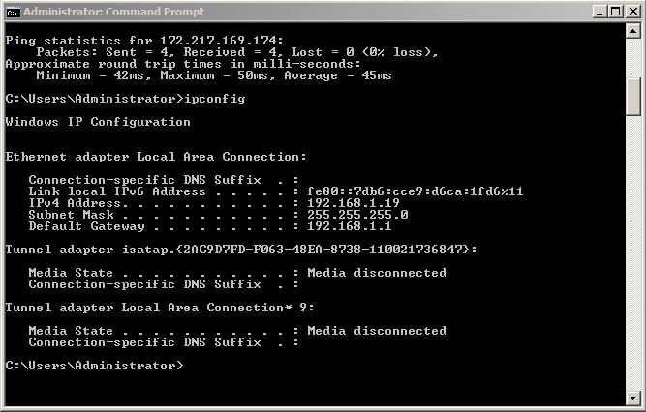
Setting up the Windows 2008 Server on Oracle Virtualbox and find the IP address with «ipconfig» code.

Slide 15
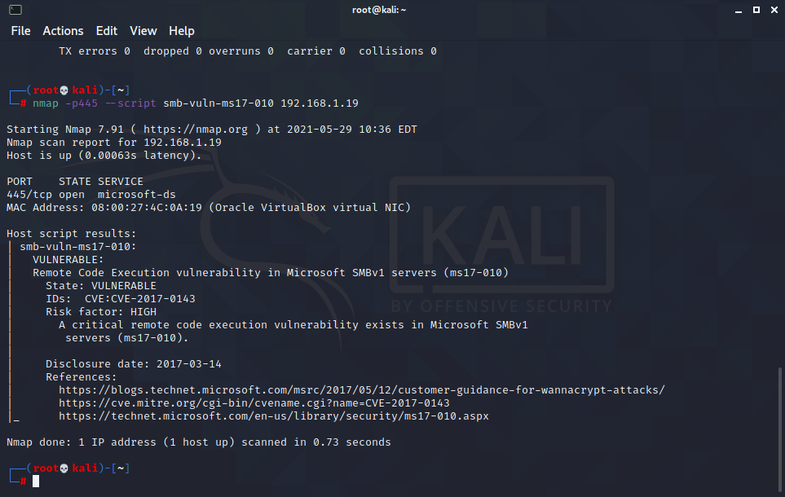
Starting the Nmap on Kali Linux. After the scan we understand the Windows machine is «VULNERABLE».

Slide 16
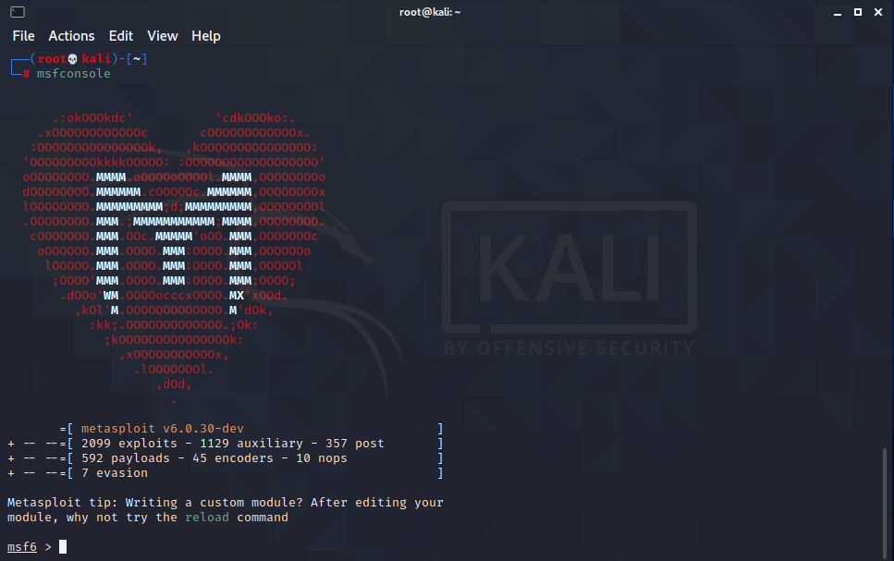
Starting «msfconsole» is succeeded.

Slide 17
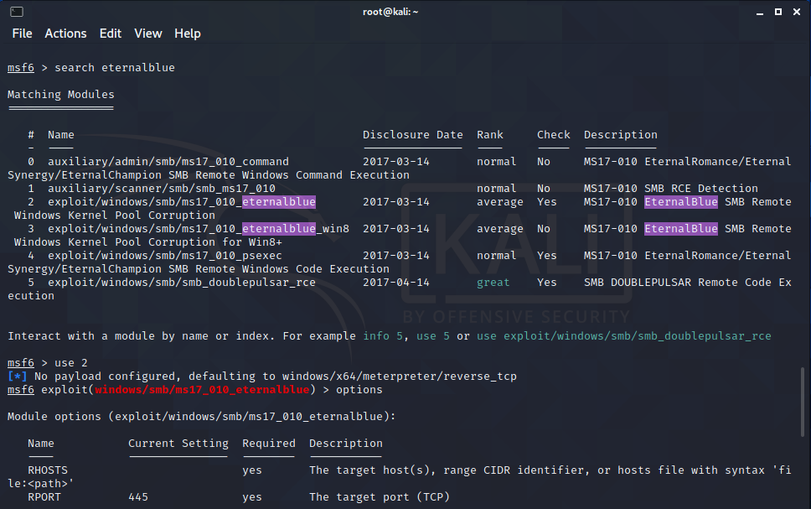
Search the module for «eternalblue».

Slide 18
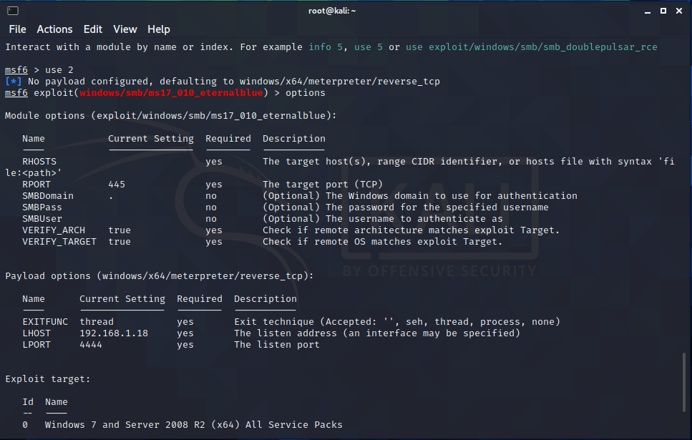
Find out the target which we will exploit.

Slide 19
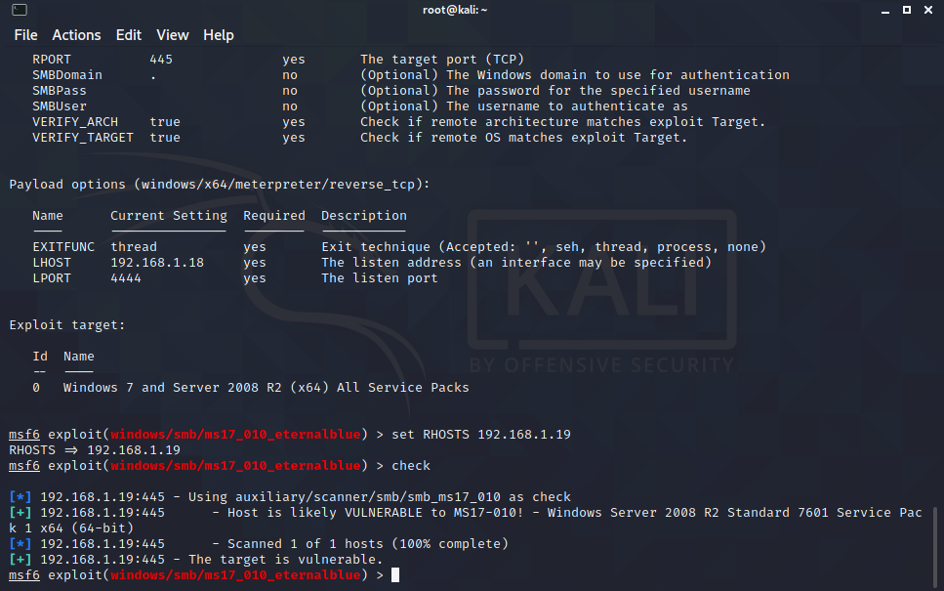
Configuring on Eternalblue for target

Slide 20
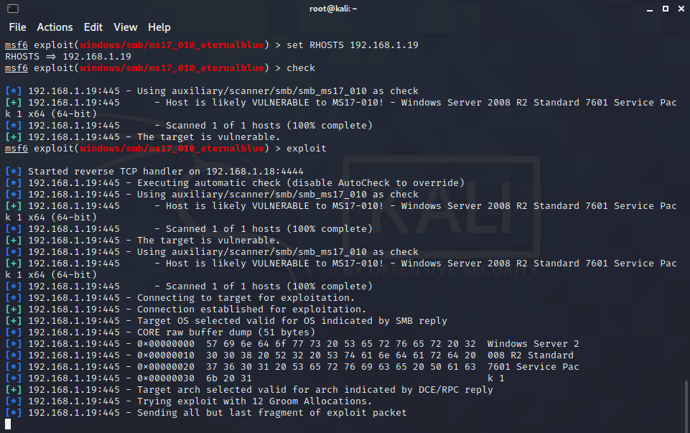
Send out the exploit packets.

Slide 21
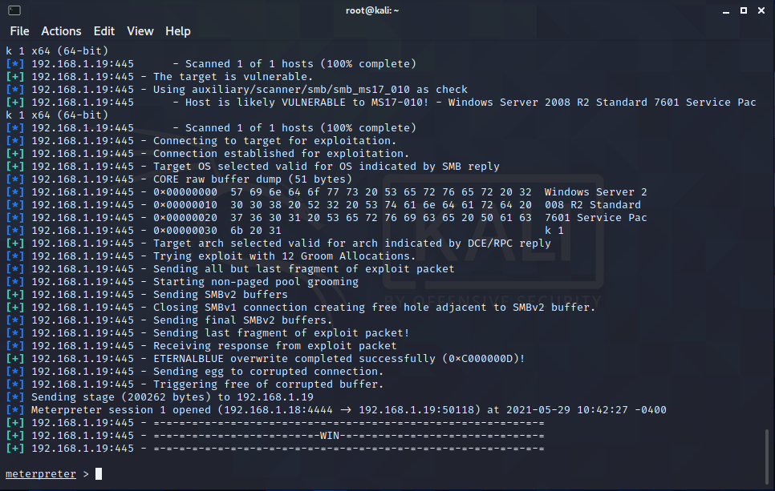
Send out the exploit packets successfully.

Slide 22
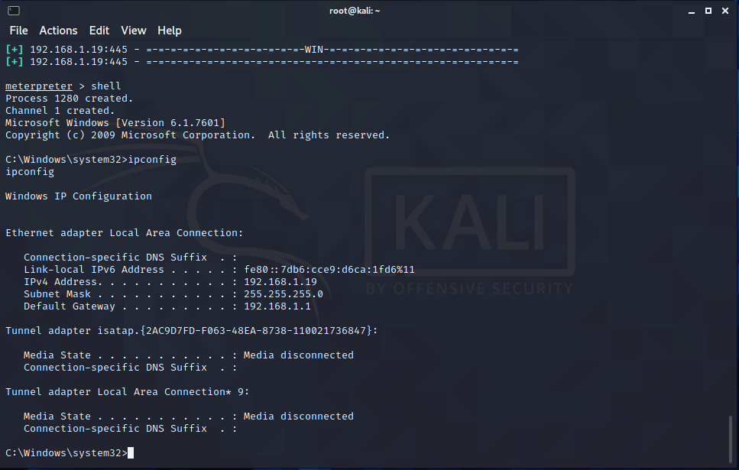
We leaked to the target machine.

Slide 23
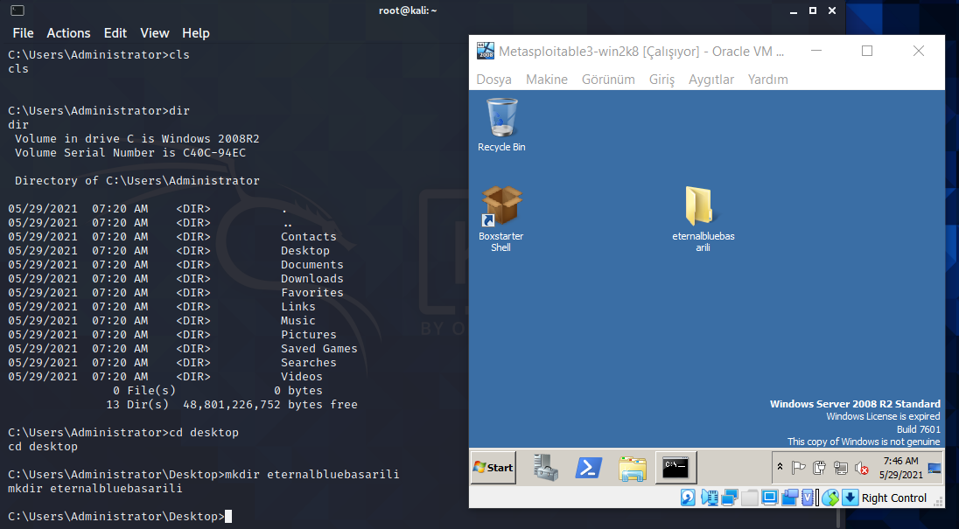
We created a file on Windows machine with using Kali Linux terminal.

Slide 24
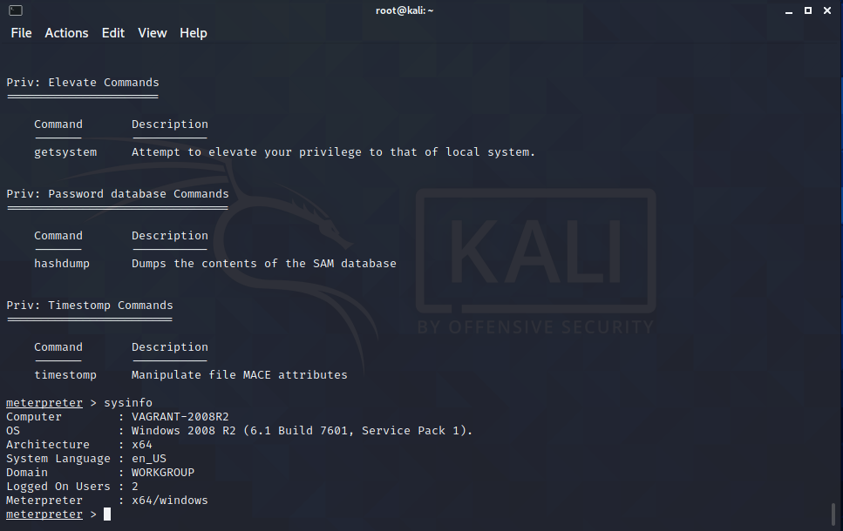
Found out the information about Windows machine.

Slide 25
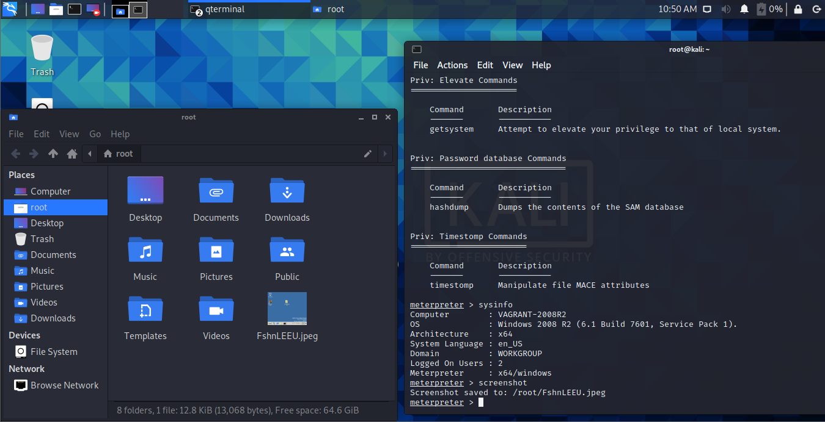
Took a screenshot on Windows and saved it in the Kali.

Slide 26
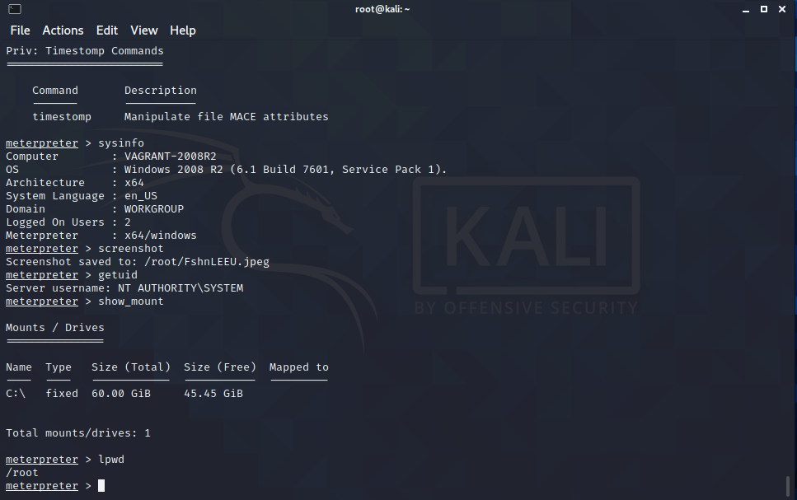
Looking to the file system’s information

Slide 27
Warning!!
Since 'meterpreter' establishes an encrypted connection, we had to configure 'eternalblue' again before 'exploit' it.
We set payload windows/shell/reverse_tcp edit required.
Then, when we clicked Exloited, we had a chance to examine it with wireshark.

Slide 28
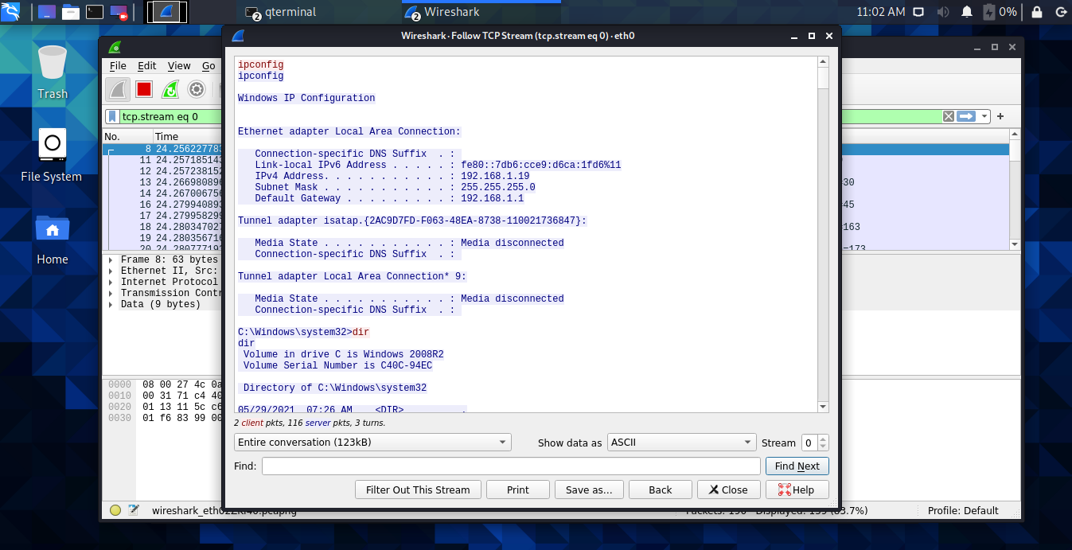
We analyzed our steps on «Wireshark».

Slide 29

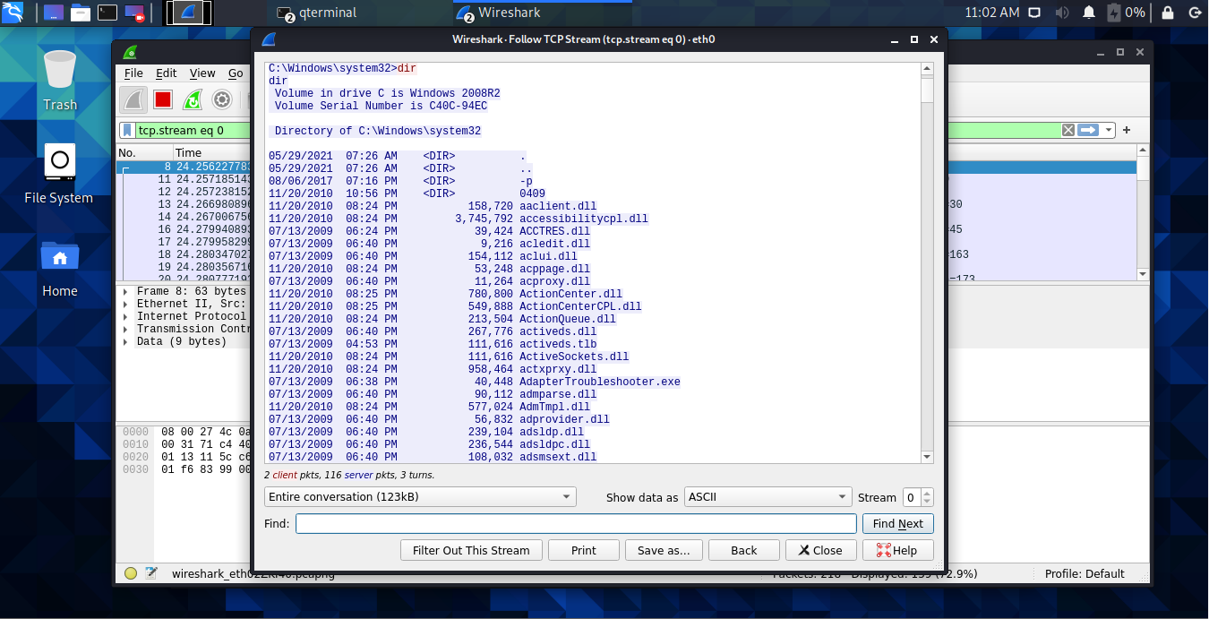
We analyzed our steps on «Wireshark».

Slide 30
Challenges We Have Faced with
First of all we had problem about installing Windows 2008 on VmWare Work Station. Then we change the Virtual Machine program and we install it on Oracle Virtualbox Program. Then we connected the Kali Linux and Windows 2008.
The second problem was internet connection. We try a lot of method for internet connection. After 5-6 try, we successfully made the internet connection for both machines.
At the last stage of the project, the Windows 2008 Server machine we installed became inoperable due to the exploit packages we were constantly sending and crashed every time we installed it. That's why we ended our project by making limited transactions.

Slide 31
Thank You!
Thank you very much for this assignment. We did a lot of research and learned a lot.
Thank you for listening!

